Slide 1

UÇUŞA HAZIR MIYIZ?

Slide 2
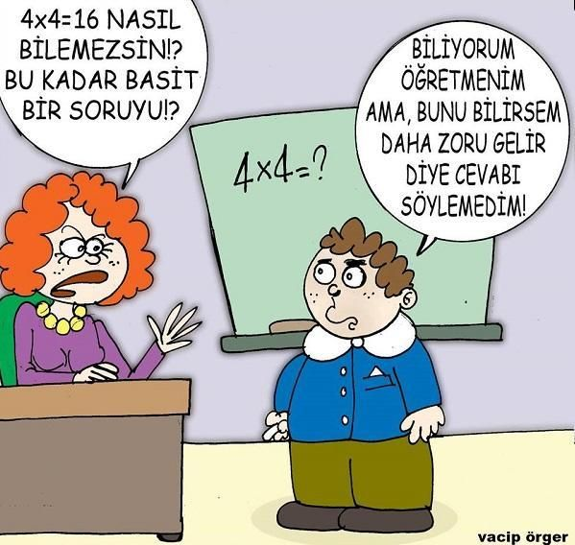
Derste Özgür Olma

Slide 3

Nerede Olduğumuzun Farkında mıyız?

Slide 4
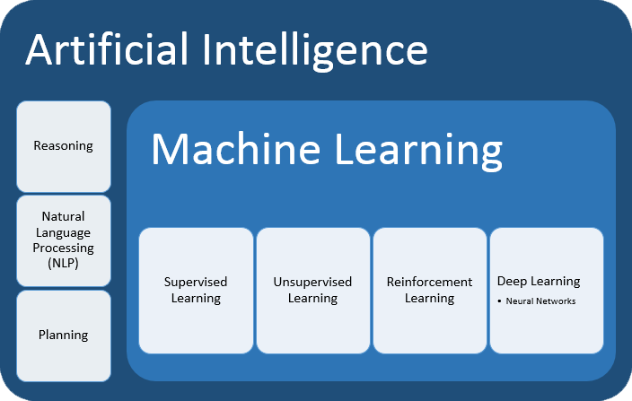
Machine learning

Slide 5
ML Steps
Understanding the Dataset:
Data Exploration:
Data Preprocessing:
Feature Selection:
Model Selection:
Model Tunning:
Model Evaluation:

Slide 6
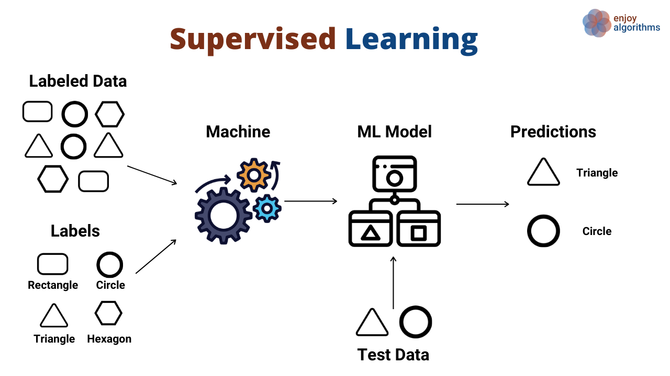
CLASSIFICATION MODELS

Slide 7
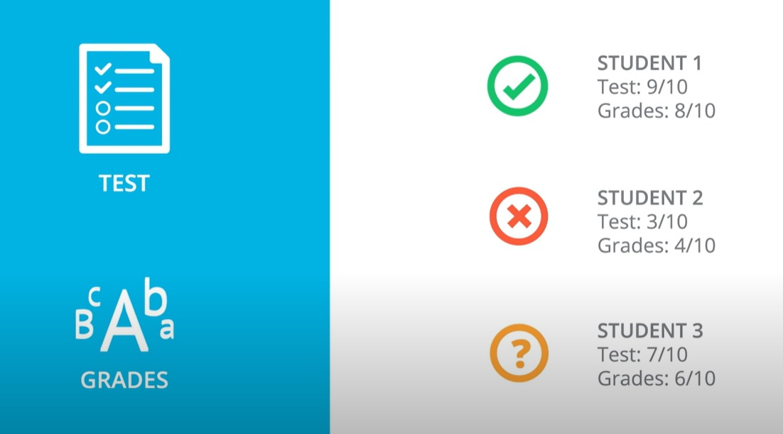
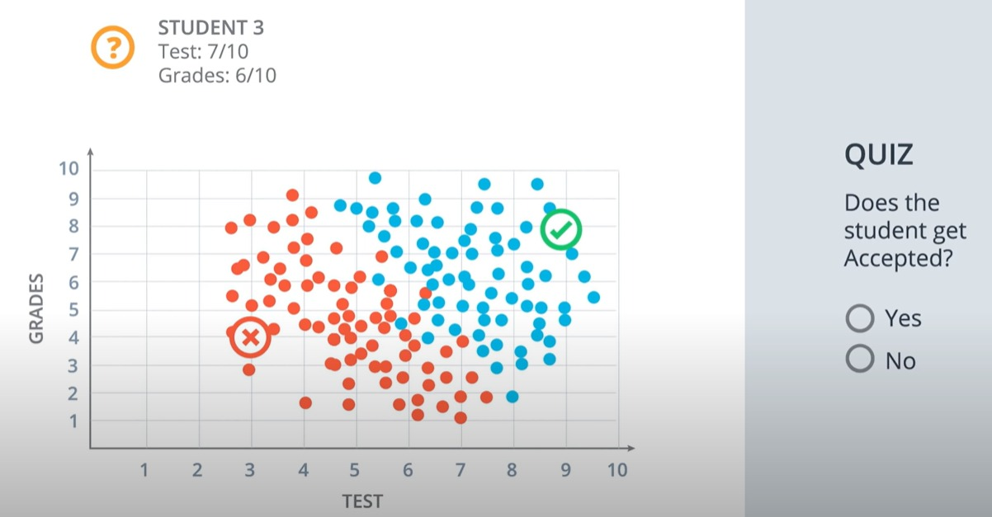
Classification

Slide 8
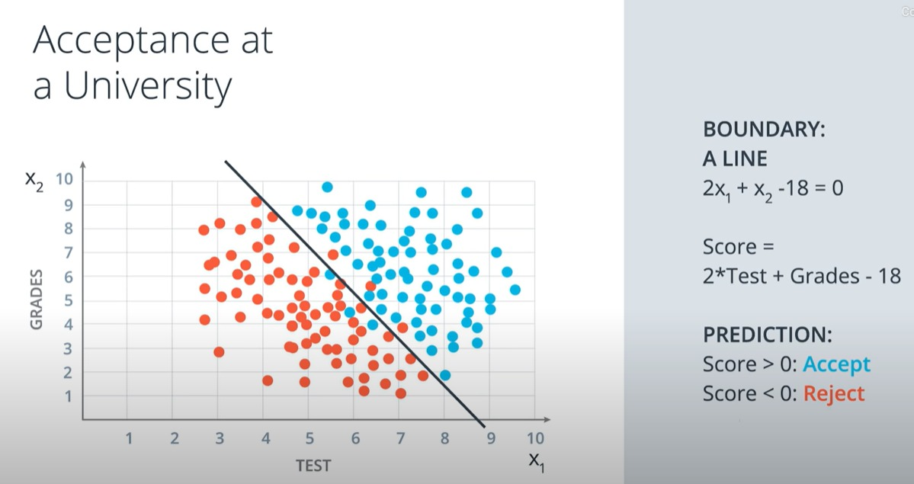
Classification

Slide 9
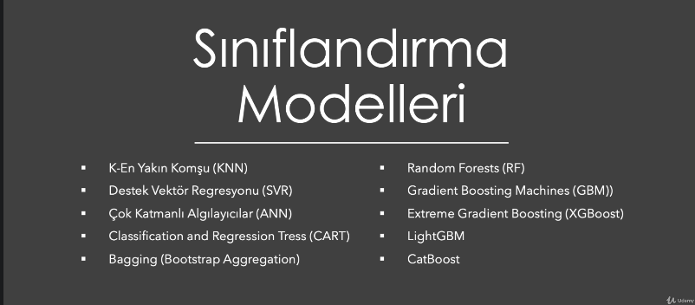
CLASSIFICATION MODELS

Slide 10
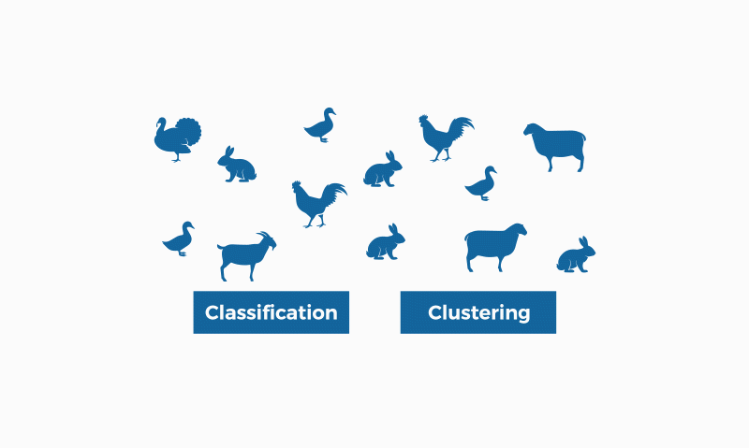
CLASSIFICATION MODELS

Slide 11
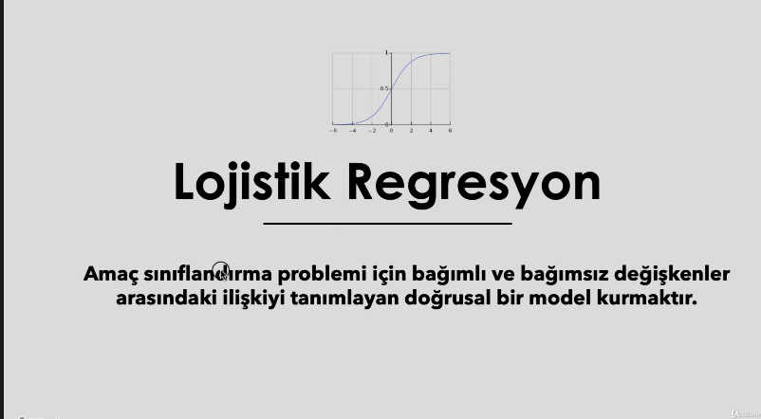
Logistic Regression

Slide 12
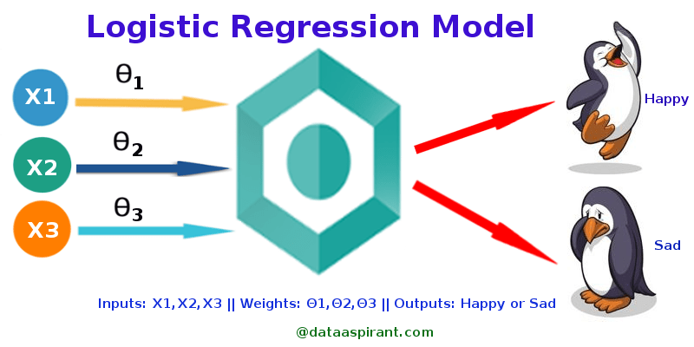
Logistic Regression

Slide 13
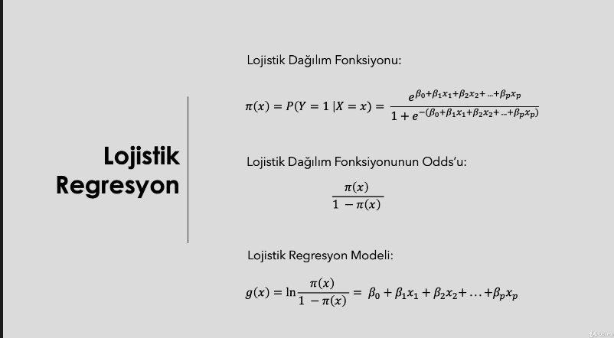
Logistic Regression

Slide 14
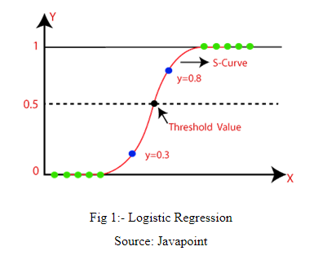
Logistic Regression

Slide 15
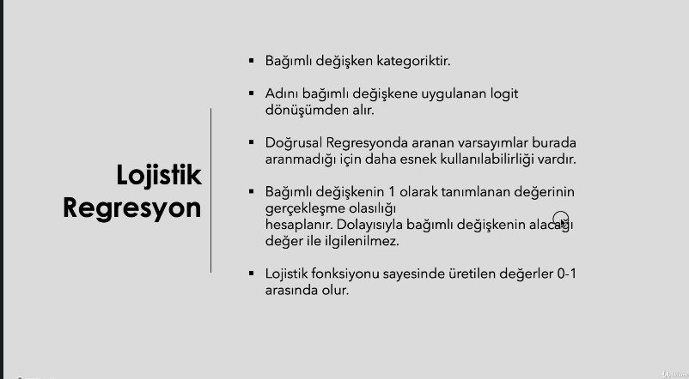
Logistic Regression

Slide 16
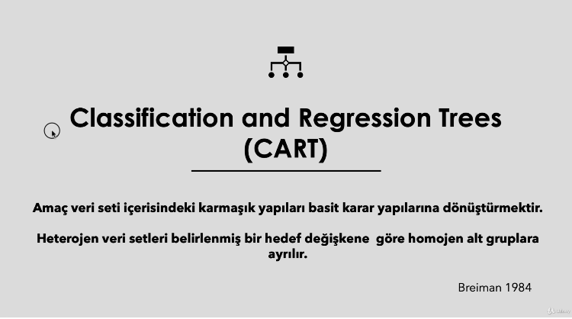
CART (Decission Tree)

Slide 17
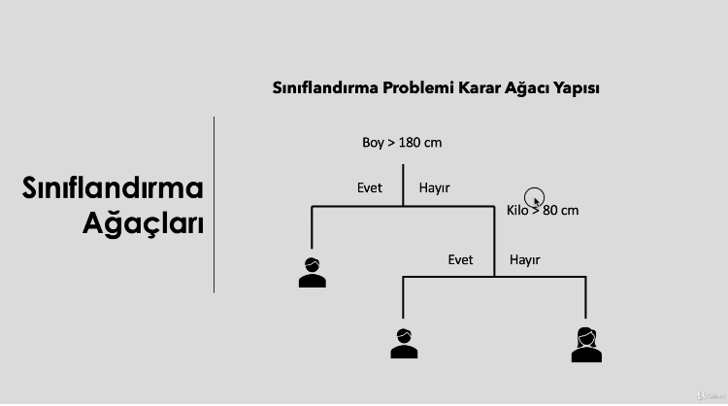
CART (Decission Tree)

Slide 18
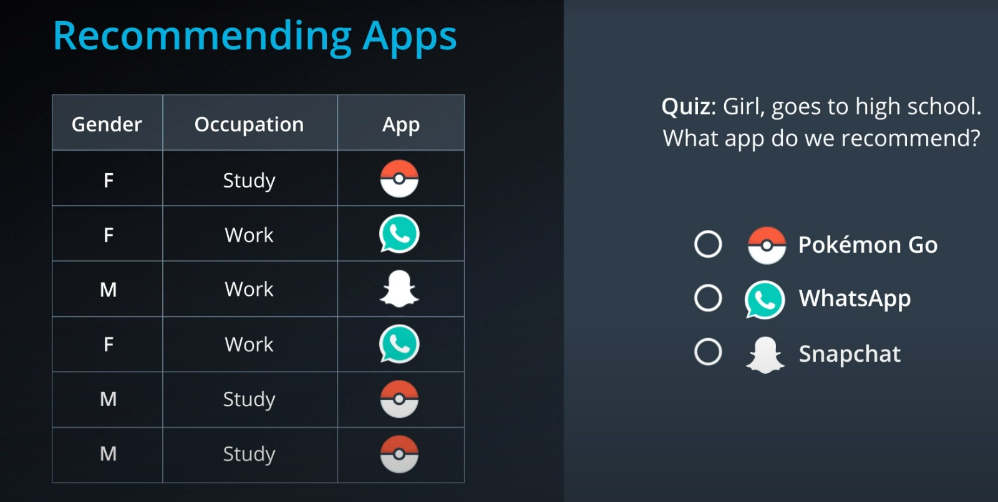
CART (Decission Tree)

Slide 19
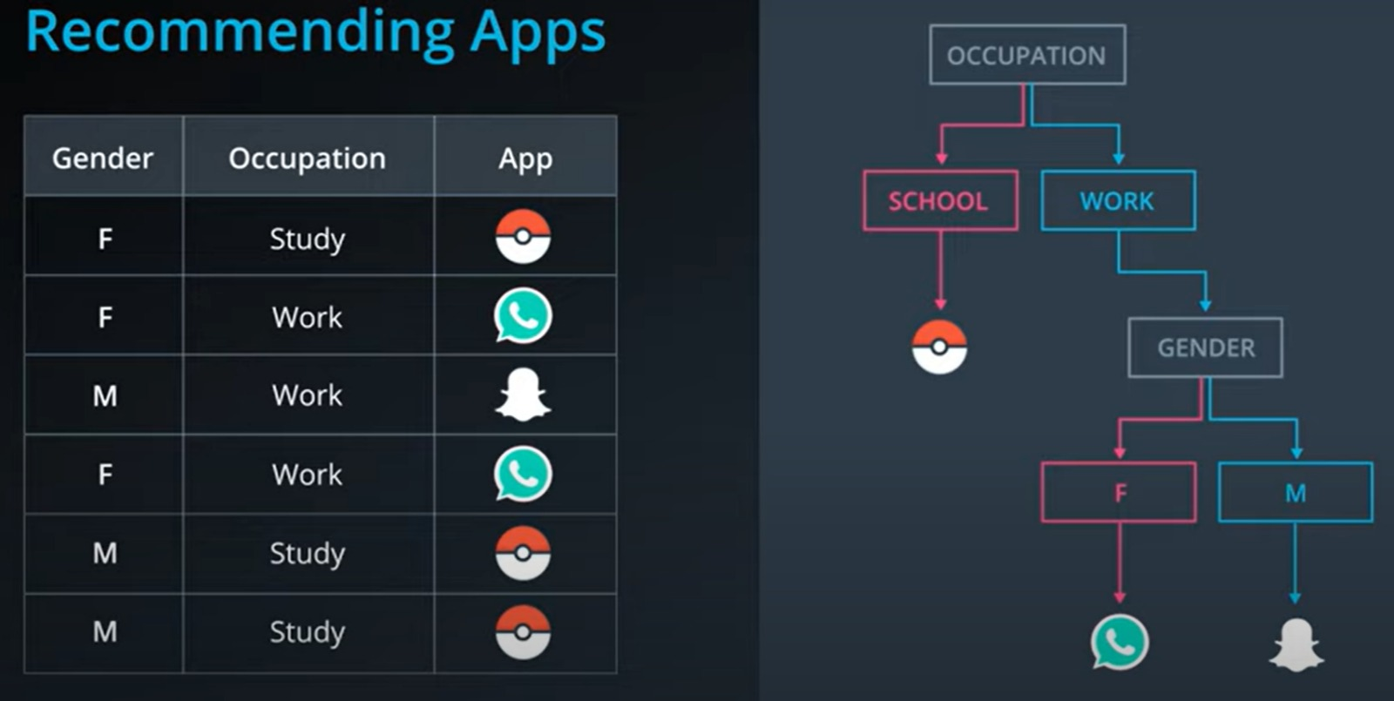
CART (Decission Tree)

Slide 20
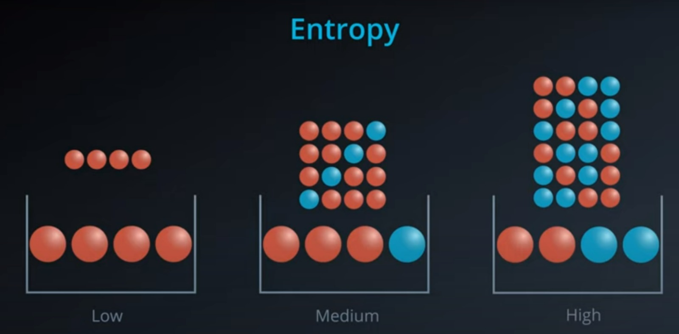
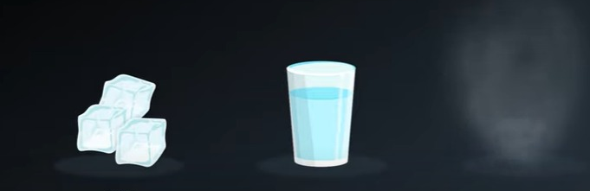
CART (Decission Tree)

Slide 21
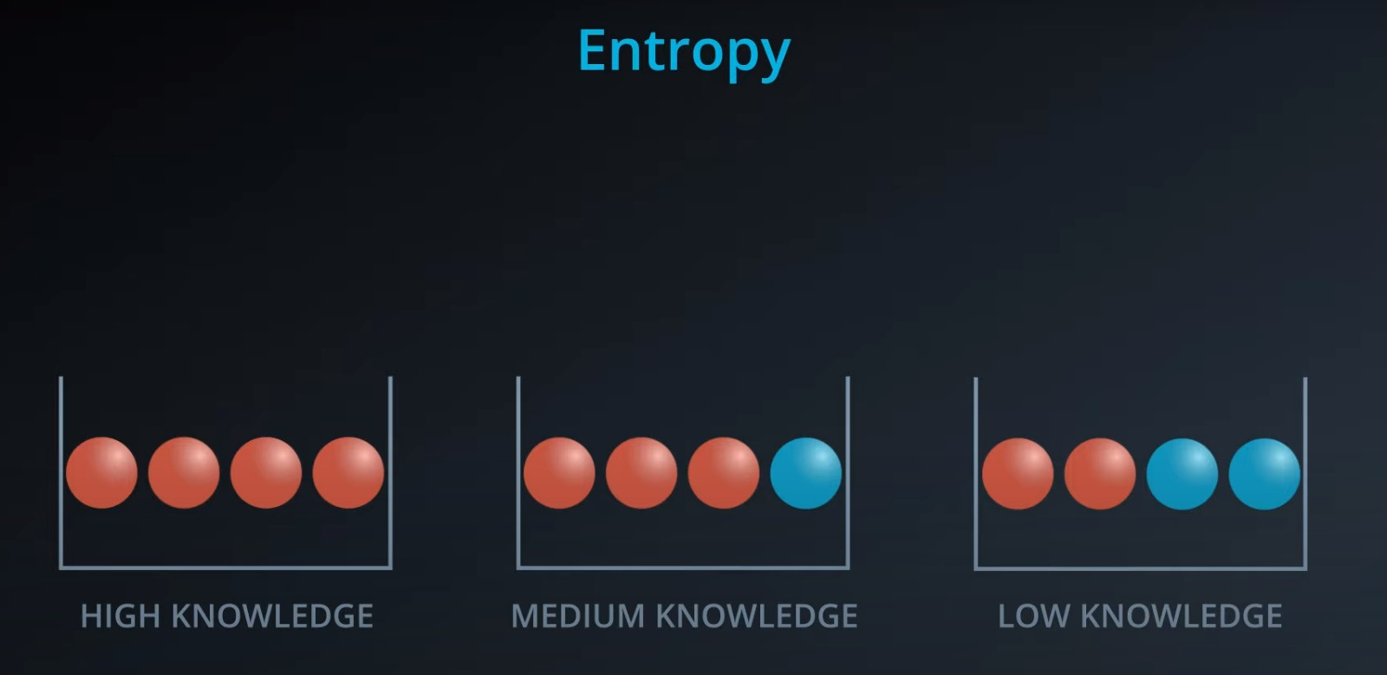
CART (Decission Tree)

Slide 22
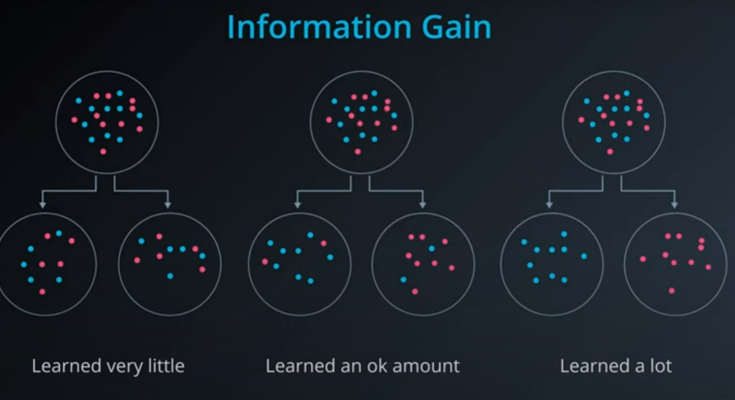
CART (Decission Tree)

Slide 23
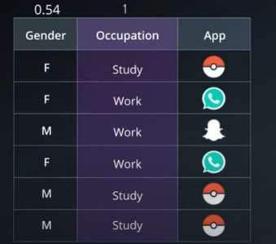
CART (Decission Tree)

Slide 24
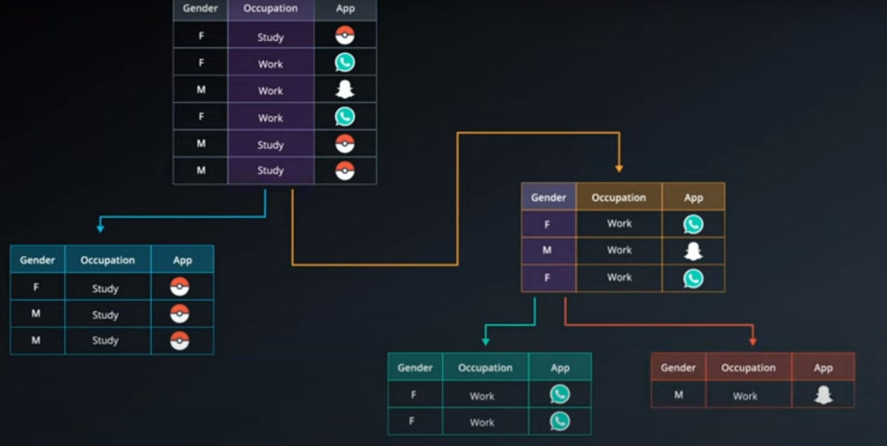
CART (Decission Tree)

Slide 25
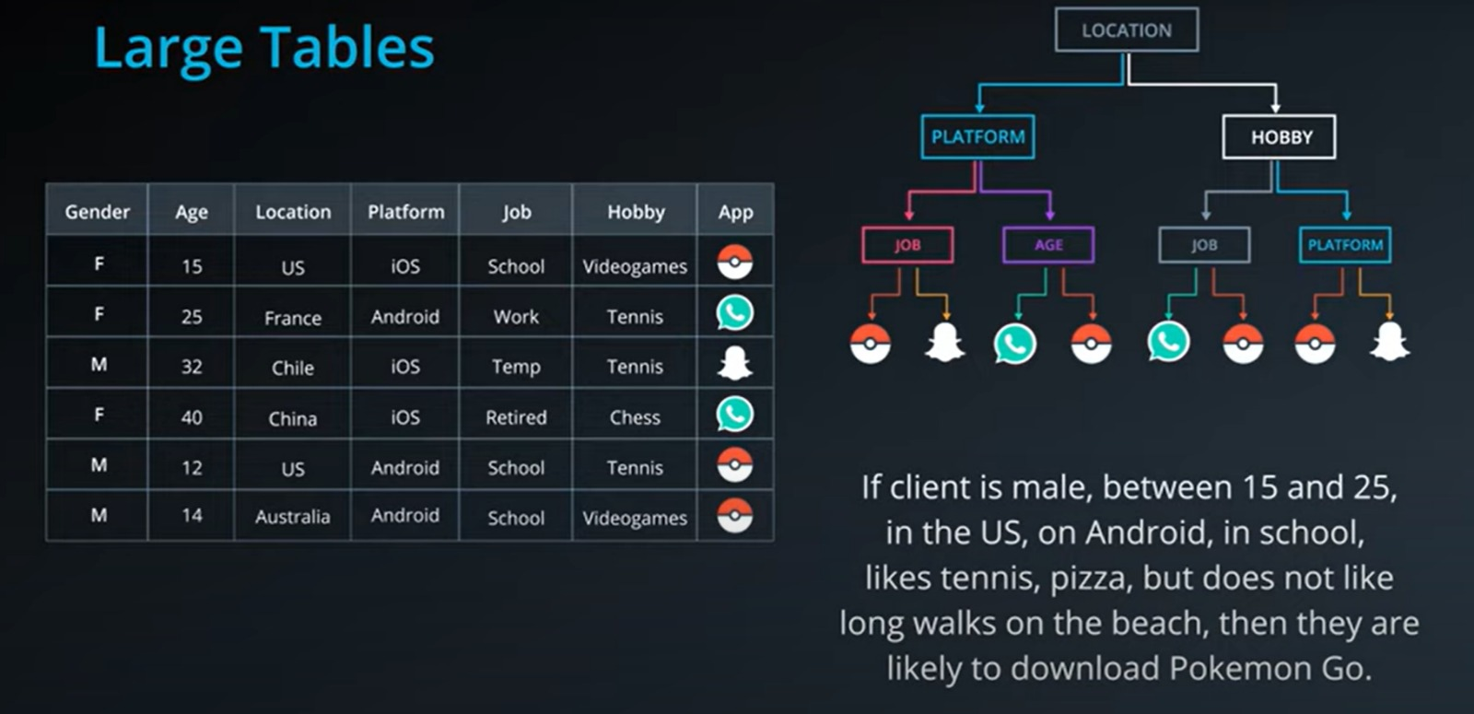
CART (Decission Tree)

Slide 26
CART (Overfitting of Decission Tree)
OVERFITTING

Slide 27
CART (Overfitting’i nasıl önleriz?)

Slide 28
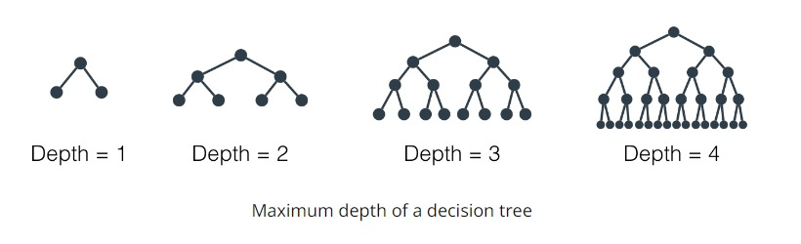
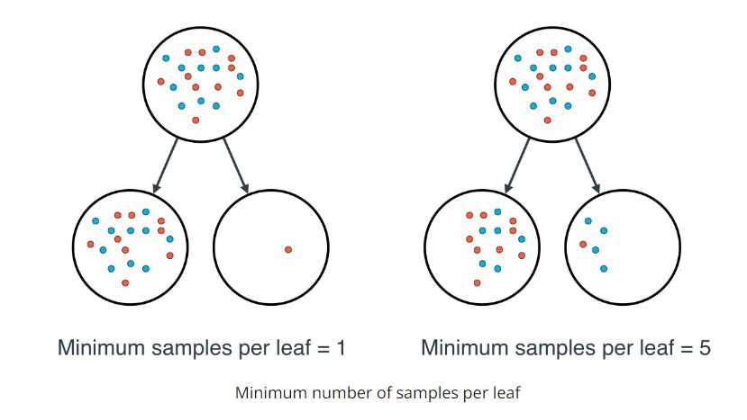
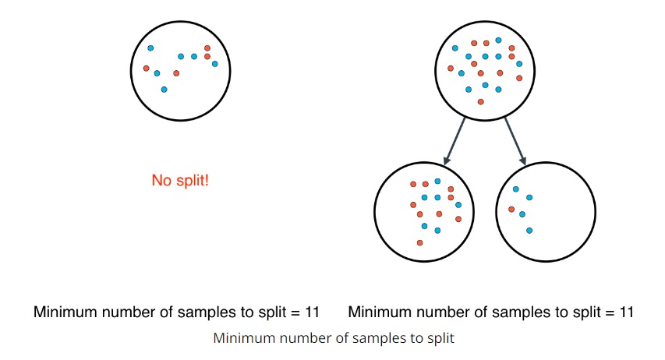
Hyperparametres of CART
Max Depth
Minimum samples per leaf
Minimum number of samples to split

Slide 29

Extra Info - Cross Validation

Slide 30

Naive Bayes

Slide 31
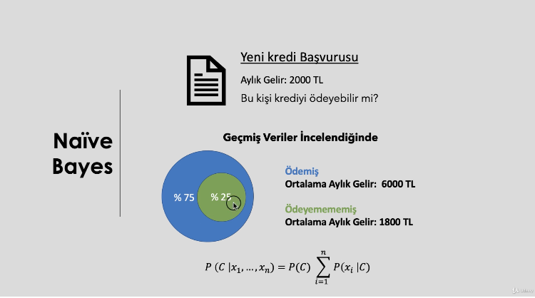
Naive Bayes

Slide 32
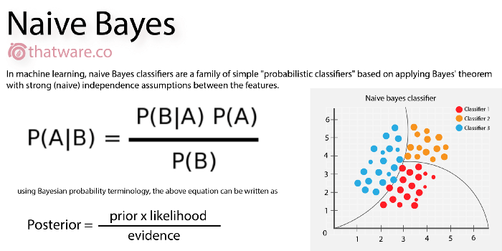
Naive Bayes

Slide 33
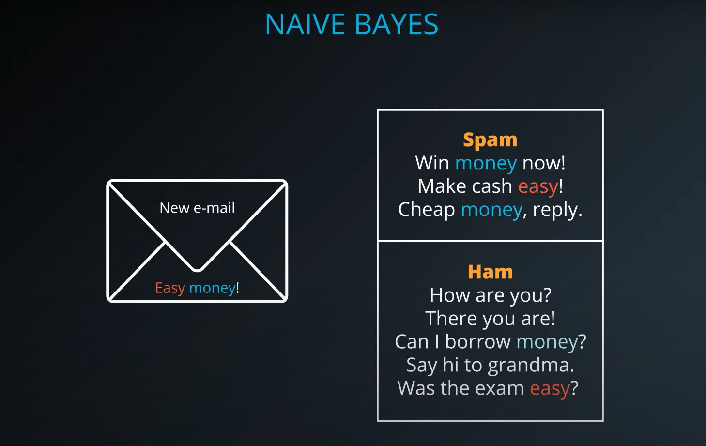
Naive Bayes

Slide 34
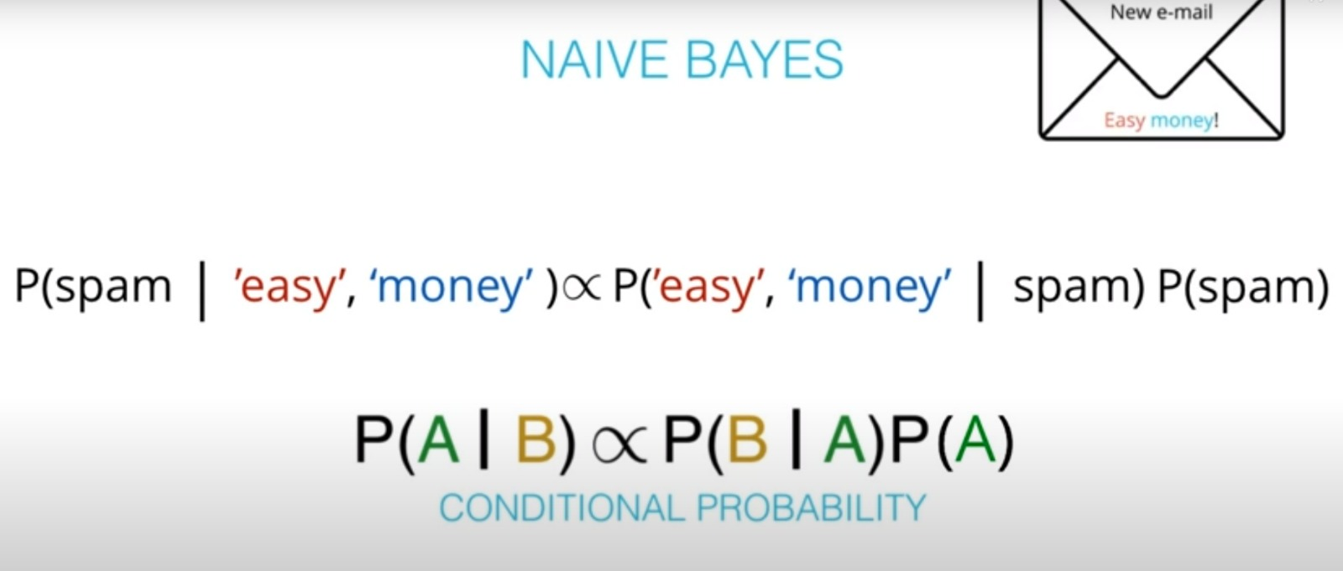
Naive Bayes

Slide 35
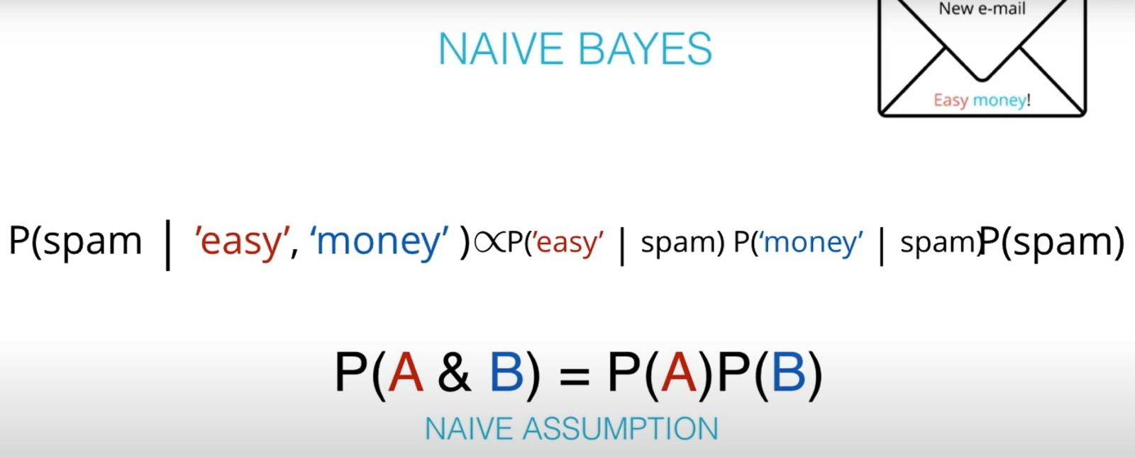
Naive Bayes

Slide 36
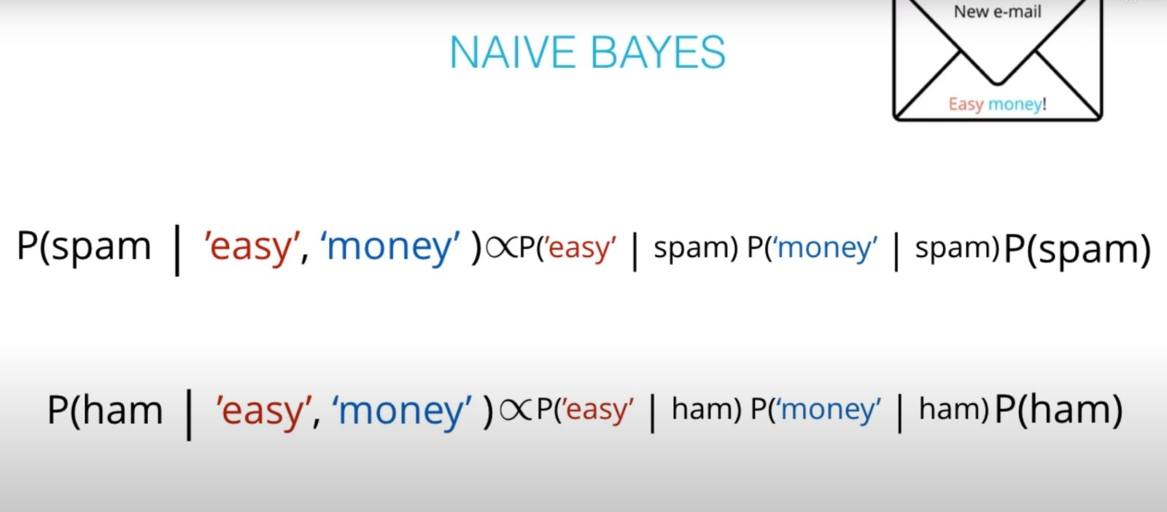
Naive Bayes

Slide 37

KNN

Slide 38
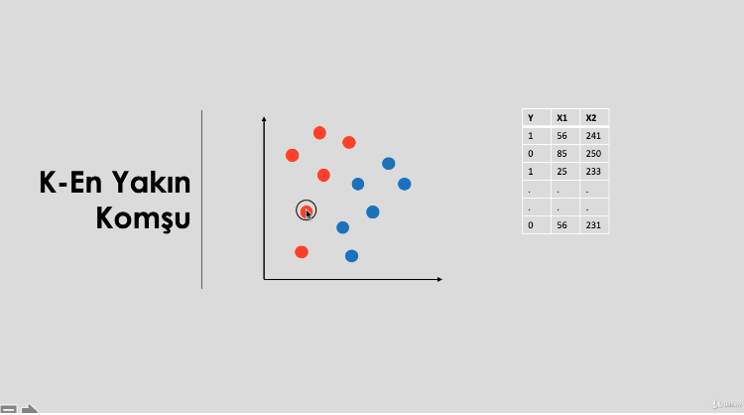
KNN

Slide 39
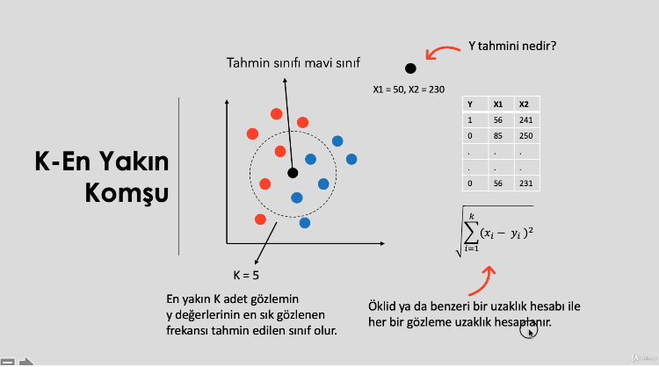
KNN

Slide 40
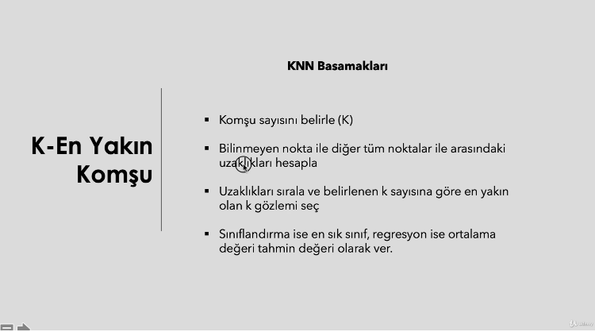
KNN

Slide 41
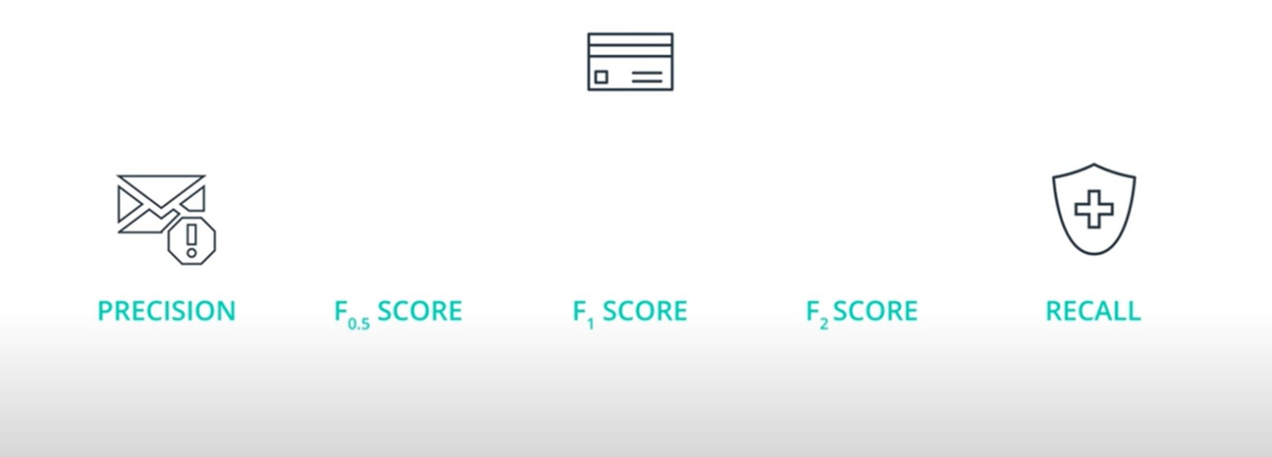
*Extra Info

Slide 42

SVC

Slide 43
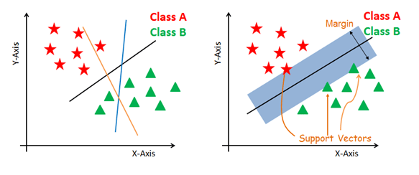
SVC

Slide 44
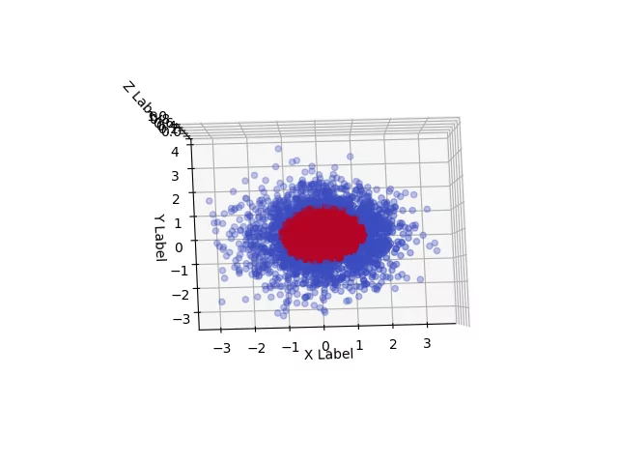
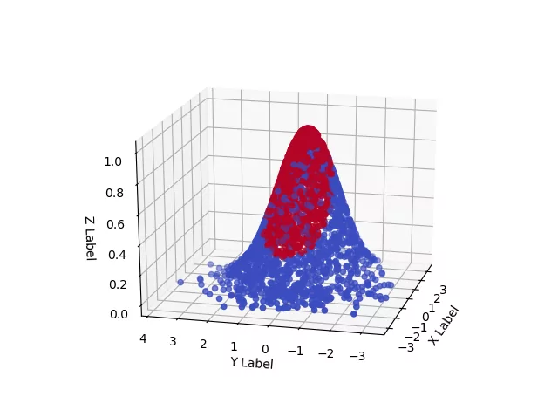
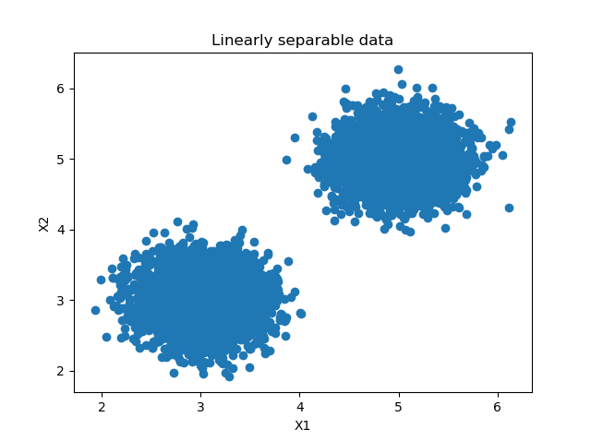
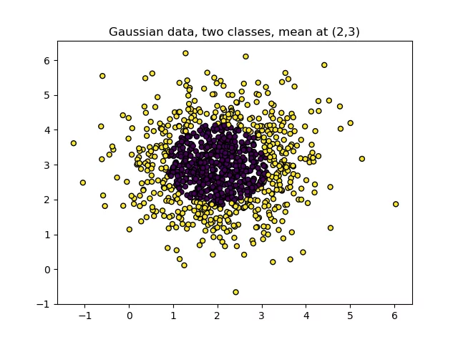
SVC
RBF to our nonlinear dataset?

Slide 45
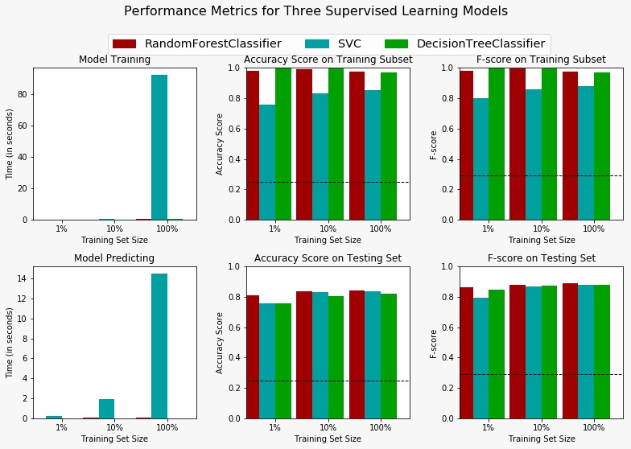
SVC Karşılaştırma

Slide 46
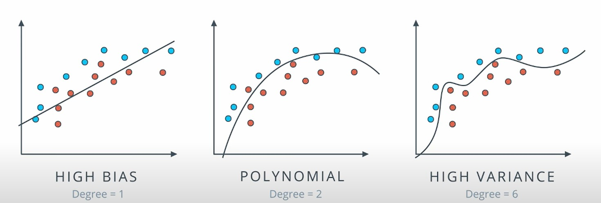
Extra Info (Underfitting, Overfitting) Model Bias and Model Variance

Slide 47
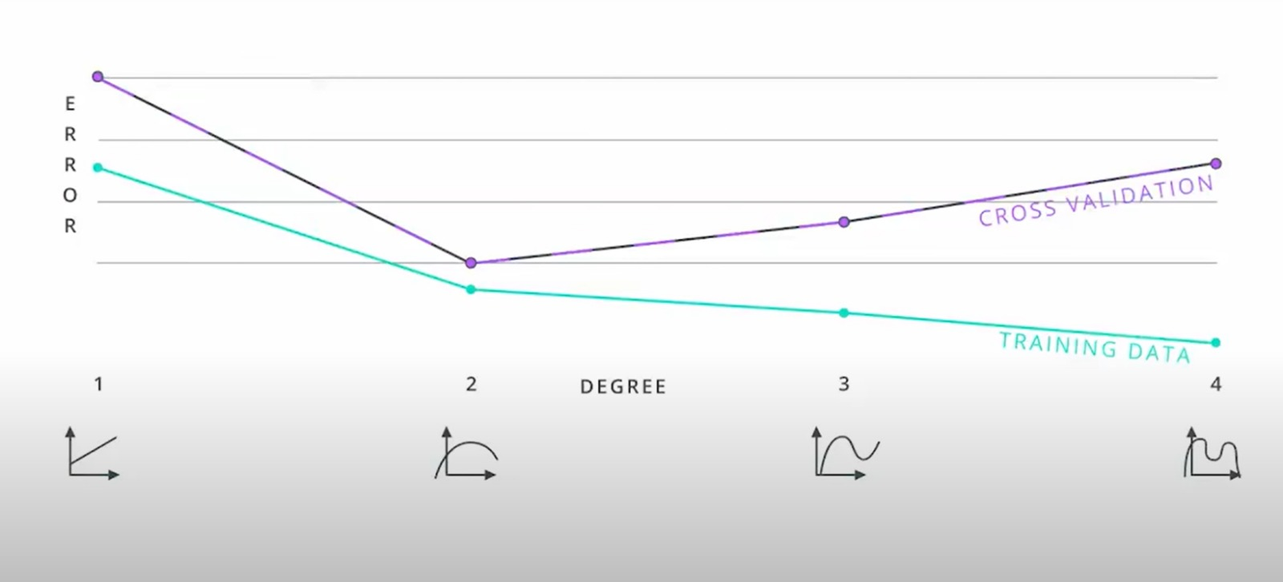
Extra Info (Model Complexity)

Slide 48
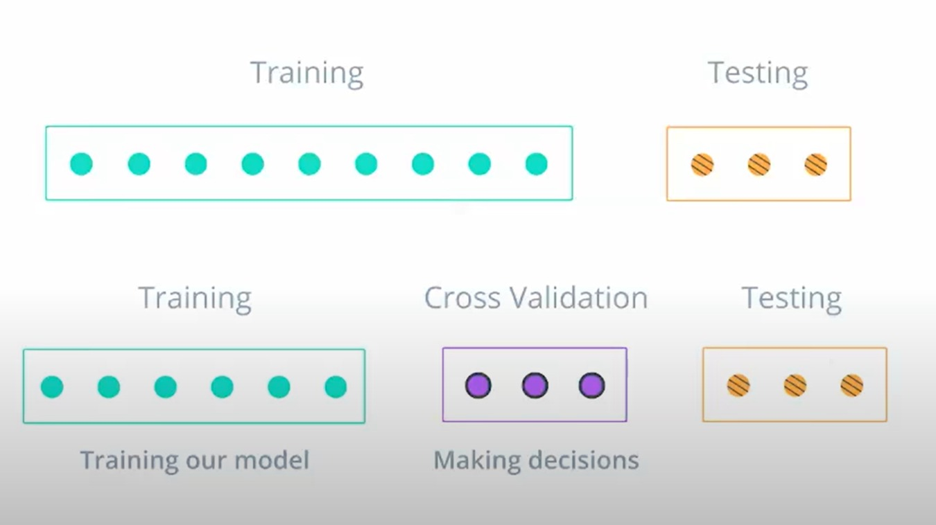
Extra Info Cross Validation

Slide 49
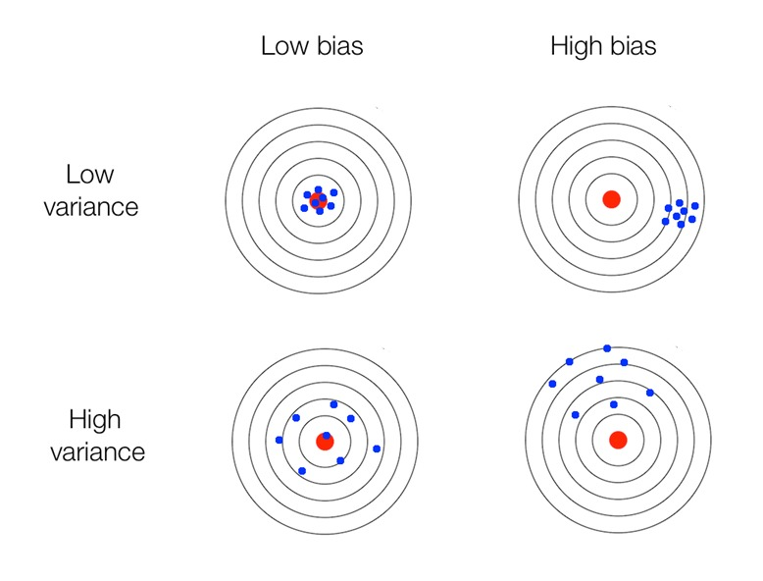
Extra Info – Model Variance and Model Bias

Slide 50
Extra Info – Model Variance and Model Bias

Slide 51
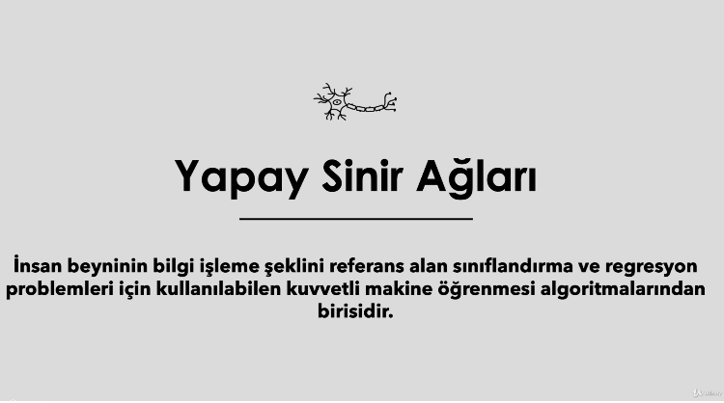
ANN

Slide 52
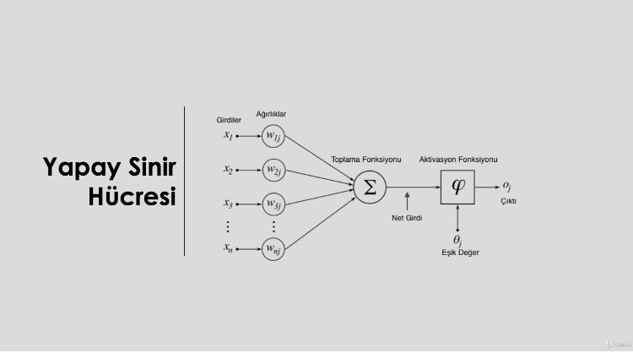
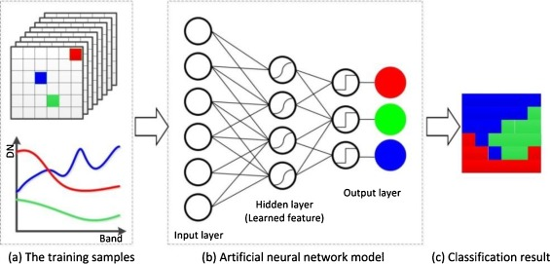
SVC

Slide 53

RF

Slide 54

RF

Slide 55

RF

Slide 56

Extra Info - Feature Importance

Slide 57

GBM

Slide 58

GBM

Slide 59

GBM

Slide 60

XGBOOST

Slide 61

XGBOOST

Slide 62

LightGBM

Slide 63

LightGBM

Slide 64

CatBoost

Slide 65

CatBoost

